Slide 1
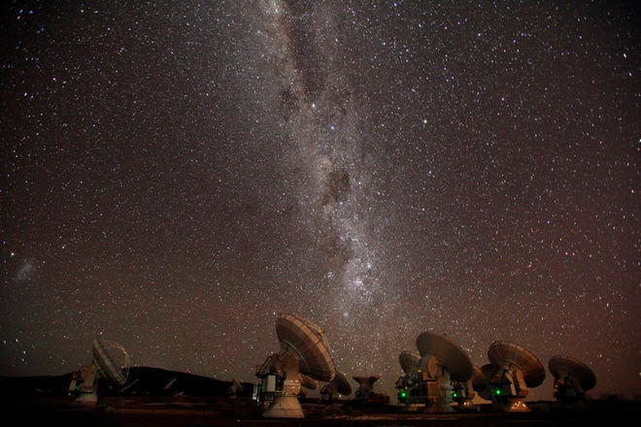
Applications of Matched Filtering for Improved Interferometric Imaging and Weak Line Detection
Ryan A. Loomis (Harvard-Smithsonian CfA)
Collaborators: K. Öberg, S. Andrews, C. Walsh, I. Czekala, J. Huang

Slide 2
Improvements with new interferometers

Slide 3
Improvements with new interferometers
  Spatial resolution

Slide 4
Improvements with new interferometers
  Spatial resolution
  Sensitivity

Slide 5
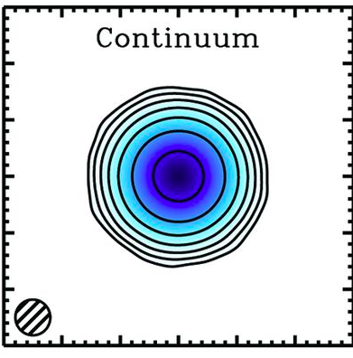
Improvements with new interferometers
TW Hya
  Spatial resolution
  Sensitivity
ALMA + (2015)

Slide 6
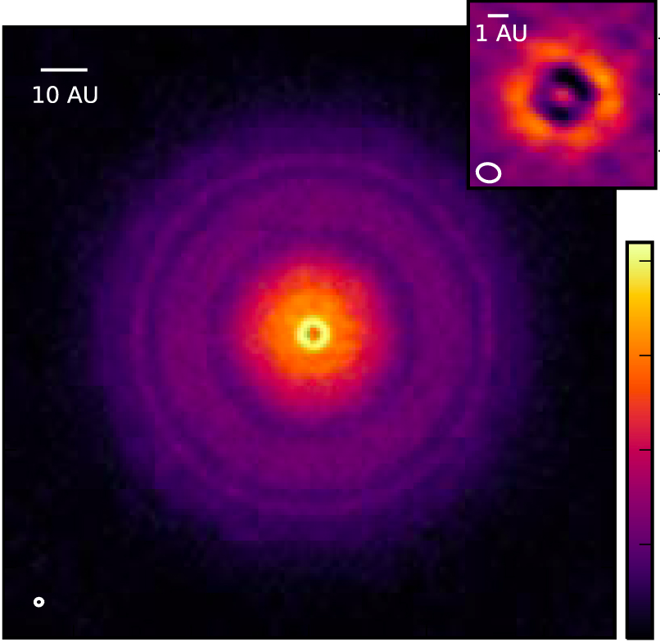
Improvements with new interferometers
TW Hya
  Spatial resolution
  Sensitivity
ALMA + (2015)
Andrews + (2016)

Slide 7
Improvements with new interferometers
TW Hya
  Spatial resolution
  Sensitivity
  Bandwidth
ALMA + (2015)
Andrews + (2016)

Slide 8
Improvements with new interferometers
TW Hya
  Spatial resolution
  Sensitivity
  Bandwidth
  Spectral resolution
ALMA + (2015)
Andrews + (2016)

Slide 9
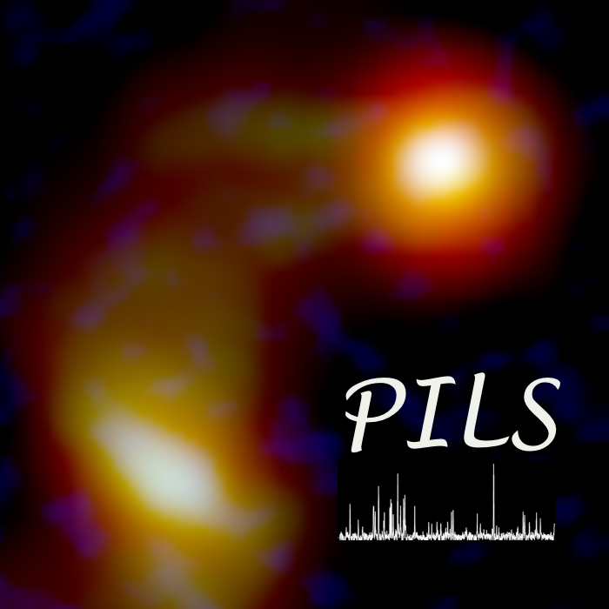
Improvements with new interferometers
TW Hya
  Spatial resolution
  Sensitivity
  Bandwidth
  Spectral resolution
ALMA + (2015)

Slide 10
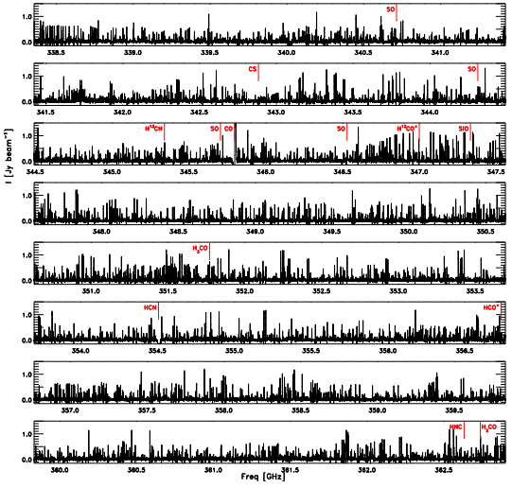
Improvements with new interferometers
TW Hya
  Spatial resolution
  Sensitivity
  Bandwidth
  Spectral resolution
ALMA + (2015)
Jorgensen + (2016)

Slide 11
Point source assumptions
TW Hya
  Spatial resolution
  Sensitivity
  Bandwidth
  Spectral resolution
ALMA + (2015)

Slide 12
Point source assumptions
TW Hya
  Spatial resolution
  Sensitivity
  Bandwidth
  Spectral resolution
ALMA + (2015)

Slide 13
Opportunities for improved techniques
TW Hya
  Spatial resolution
  Sensitivity
  Bandwidth
  Spectral resolution
ALMA + (2015)

Slide 14
Outline
  Matched filtering for improved weak spectral line detection
  Generalized Briggs weighting for improved image fidelity

Slide 15
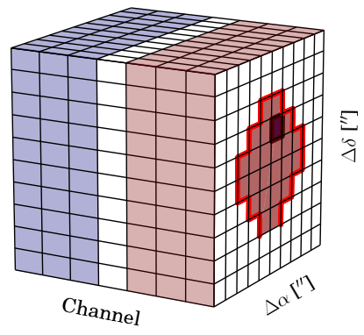
Analyzing imaged observations
Image Cube
Channel Map
[Loomis + 2018]

Slide 16
Analyzing imaged observations
Moment Maps
Image Cube
Channel Map
[Loomis + 2018]

Slide 17
Analyzing imaged observations
Moment Maps
Image Cube
Channel Map
[Loomis + 2018]

Slide 18
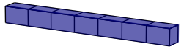
Analyzing imaged observations
Moment Maps
Image Cube
Spectra
Pixel extracted
Channel Map
[Loomis + 2018]

Slide 19
Analyzing imaged observations
Moment Maps
Image Cube
Spectra
Pixel extracted
Aperture extracted
Channel Map
[Loomis + 2018]

Slide 20
Analyzing imaged observations
Moment Maps
Image Cube
Spectra
Pixel extracted
Aperture extracted
Channel Map
[Loomis + 2018]
Mask extracted

Slide 21
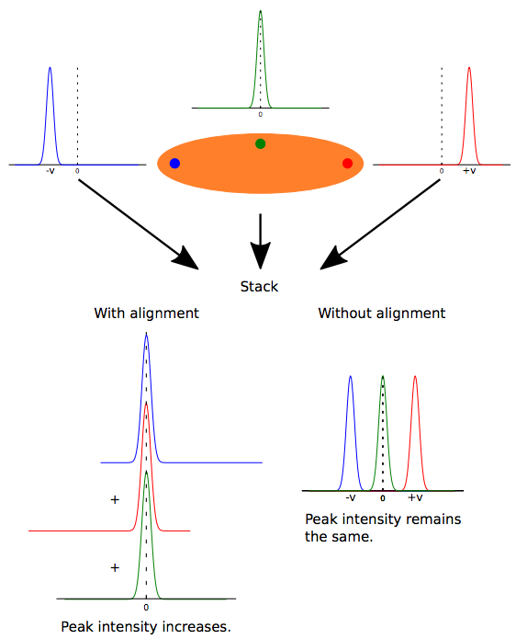
Spectral stacking
Matra + 2015
Marino + 2016
Yen + 2016

Slide 22
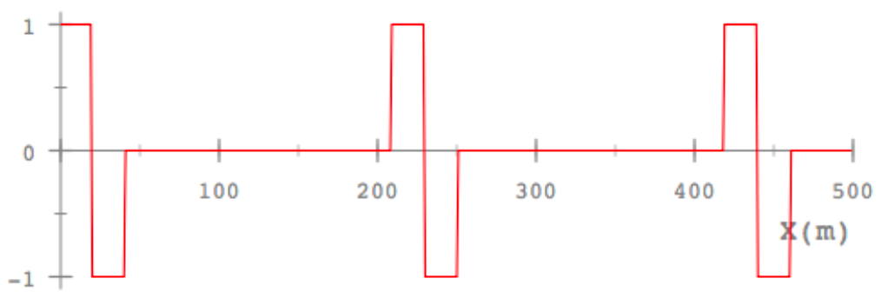
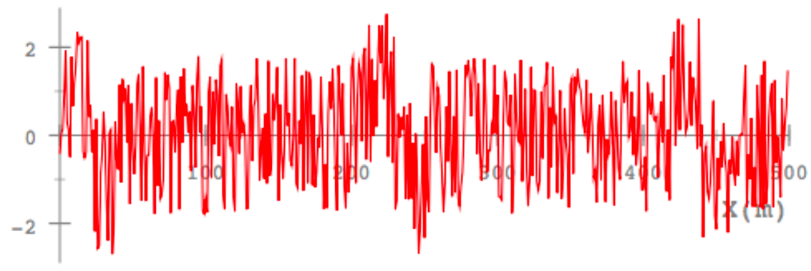
Matched filtering
Convolve known template signal with noisy data
Signal (used as filter/kernel)
Noisy signal
http://www.grauonline.de/alexwww/ardumower/filter/filter.html
https://losc.ligo.org/tutorial_optimal/

Slide 23
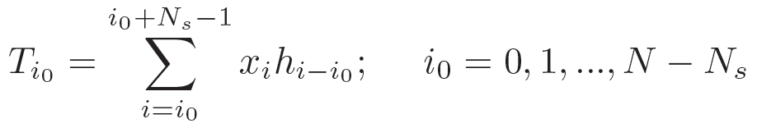
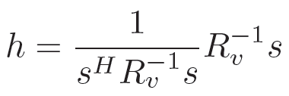
Matched filtering
Convolve known template signal with noisy data
Signal (used as filter/kernel)
Noisy signal
http://www.grauonline.de/alexwww/ardumower/filter/filter.html
https://losc.ligo.org/tutorial_optimal/

Slide 24
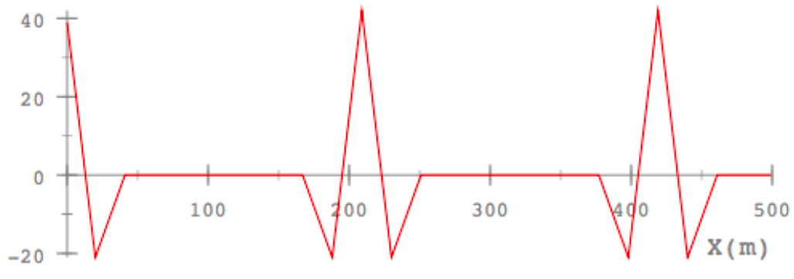
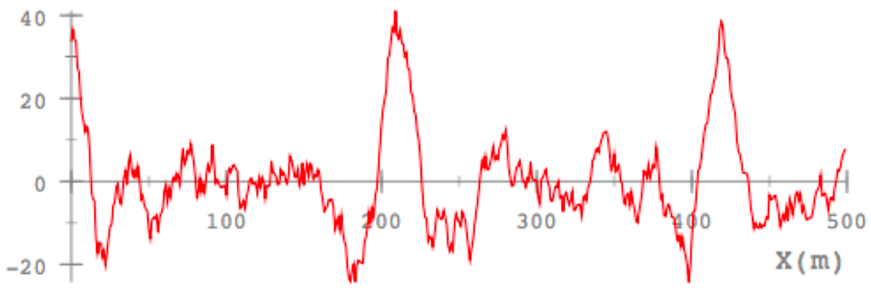
Matched filtering
Convolve known template signal with noisy data
Signal (used as filter/kernel)
Noisy signal
Filter response has highest recoverable SNR
Autocorrelation of signal
Filter response
http://www.grauonline.de/alexwww/ardumower/filter/filter.html
https://losc.ligo.org/tutorial_optimal/

Slide 25
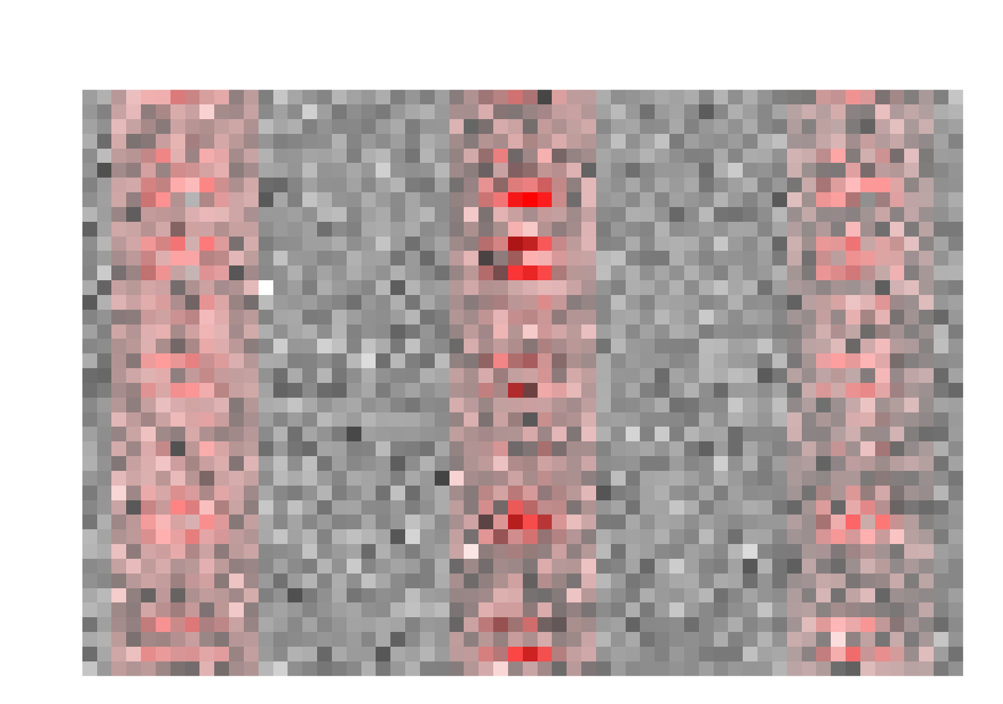
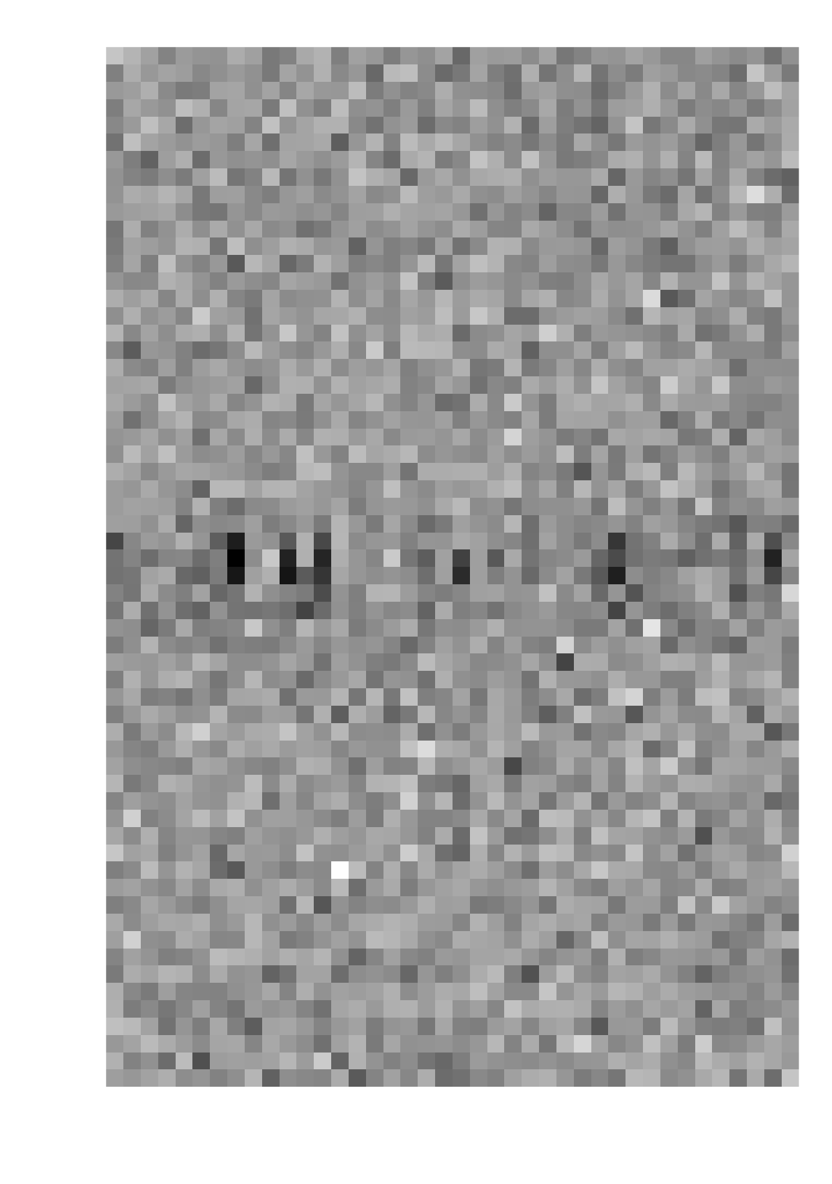

Matched filtering interferometric data
KERNEL (f)
DATA (V)
n_{k}
n_{c}
n_{uv}
n_{uv}
FFT
[Loomis + 2018]

Slide 26
Matched filtering interferometric data
KERNEL (f)
DATA (V)
n_{k}
n_{c}
*
n_{uv}
FFT
[Loomis + 2018]

Slide 27

Matched filtering interferometric data
KERNEL (f)
DATA (V)
n_{k}
n_{c}
*
n_{uv}
FFT
IMPULSE RESPONSE SPECTRUM (T)
[Loomis + 2018]

Slide 28
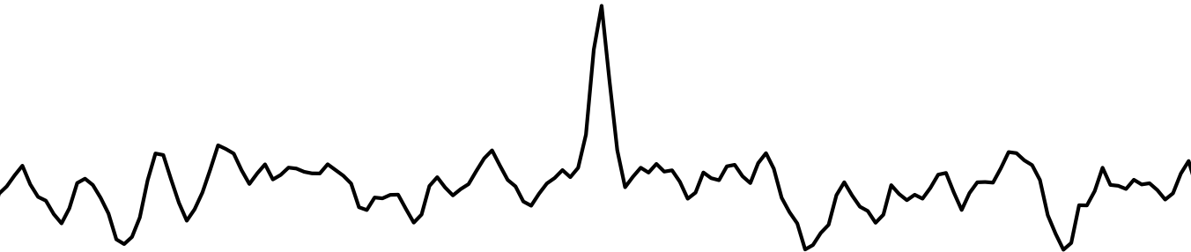
Matched filtering interferometric data
KERNEL (f)
DATA (V)
n_{k}
n_{c}
*
n_{uv}
FFT
IMPULSE RESPONSE SPECTRUM (T)
[Loomis + 2018]

Slide 29
Matched filtering interferometric data
KERNEL (f)
DATA (V)
n_{k}
n_{c}
*
*
n_{uv}
FFT
IMPULSE RESPONSE SPECTRUM (T)
[Loomis + 2018]

Slide 30
Matched filtering interferometric data
KERNEL (f)
DATA (V)
n_{k}
n_{c}
*
*
*
n_{uv}
FFT
IMPULSE RESPONSE SPECTRUM (T)
[Loomis + 2018]

Slide 31
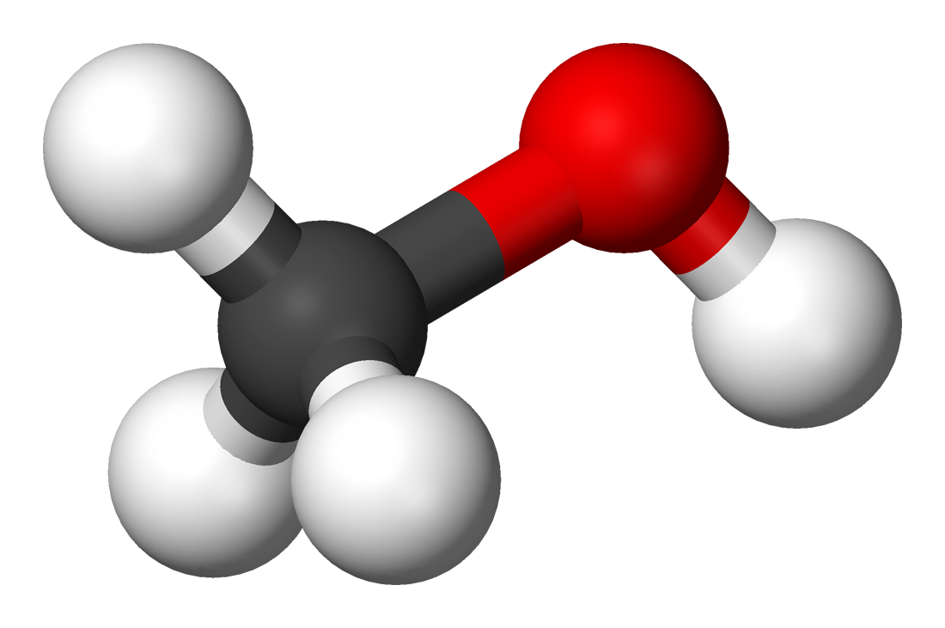
Test case #1 – CH₃OH in TW Hya
[Walsh, Loomis, Öberg + 2016]

Slide 32
Test case #1 – CH₃OH in TW Hya
[Loomis + 2018]

Slide 33
Test case #1 – CH₃OH in TW Hya
Individual lines are now detected
SNR significantly enhanced – 7.8σ after matched filtering vs 5.1σ before (53% improvement)
53% SNR boost is equivalent to a factor of 2.3 in observing time
[Loomis + 2018]

Slide 34
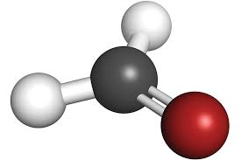
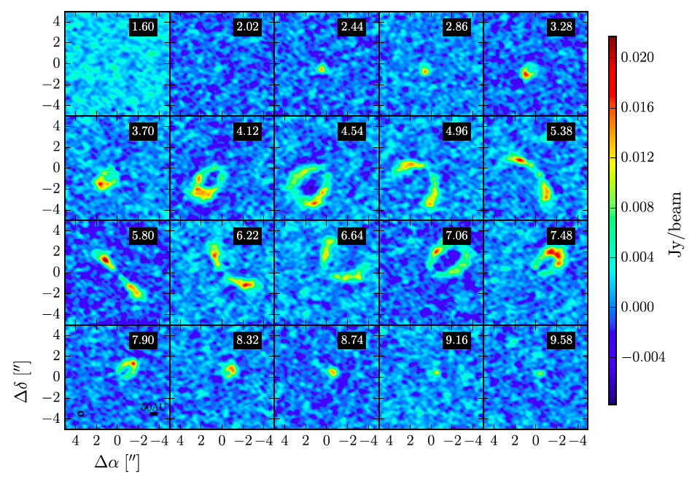
Test case #2 – H₂CO in HD 163296
H₂CO 3₀₃-2₀₂
Carney + 2017

Slide 35
Test case #2 – H₂CO in HD 163296
3₂₂-2₂₁ + 3₂₁-2₂₀ Moment-0
H₂CO 3₂₂-2₂₁ + 3₂₁-2₂₀ Stacked Spectra
Carney + 2017

Slide 36
Test case #2 – H₂CO in HD 163296
3₂₂-2₂₁ + 3₂₁-2₂₀ Moment-0
H₂CO 3₂₂-2₂₁ + 3₂₁-2₂₀ Stacked Spectra
Matched filter
>500% SNR boost!
Carney + 2017

Slide 37
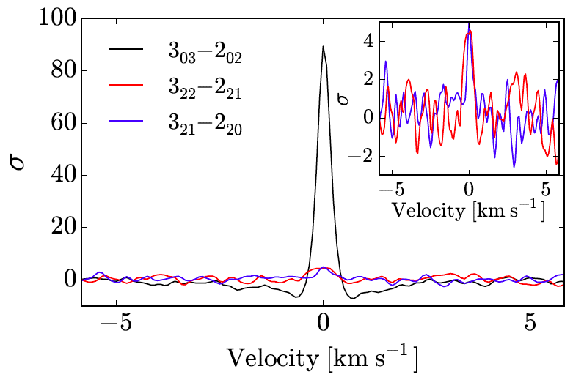
Test case #2 – H₂CO in HD 163296
H₂CO Response Spectra
H₂CO 3₂₂-2₂₁ + 3₂₁-2₂₀ Stacked Spectra
Matched filter
>500% SNR boost!
Carney + 2017

Slide 38
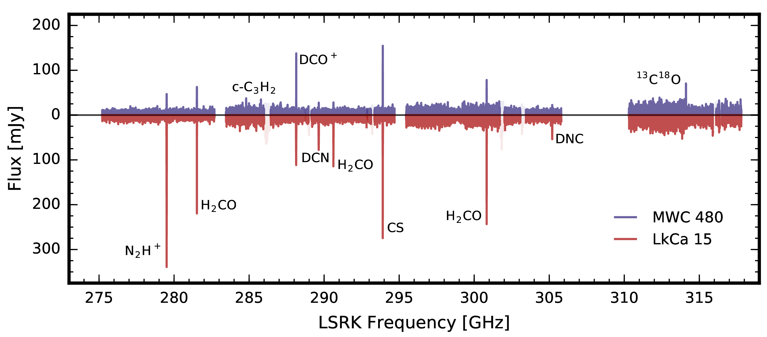
ALMA Band 7 Disk Spectral Survey
Aperture-extraction
~40-50 hrs to image, clean, and extract spectra
10 detected species
[Loomis + in prep]

Slide 39
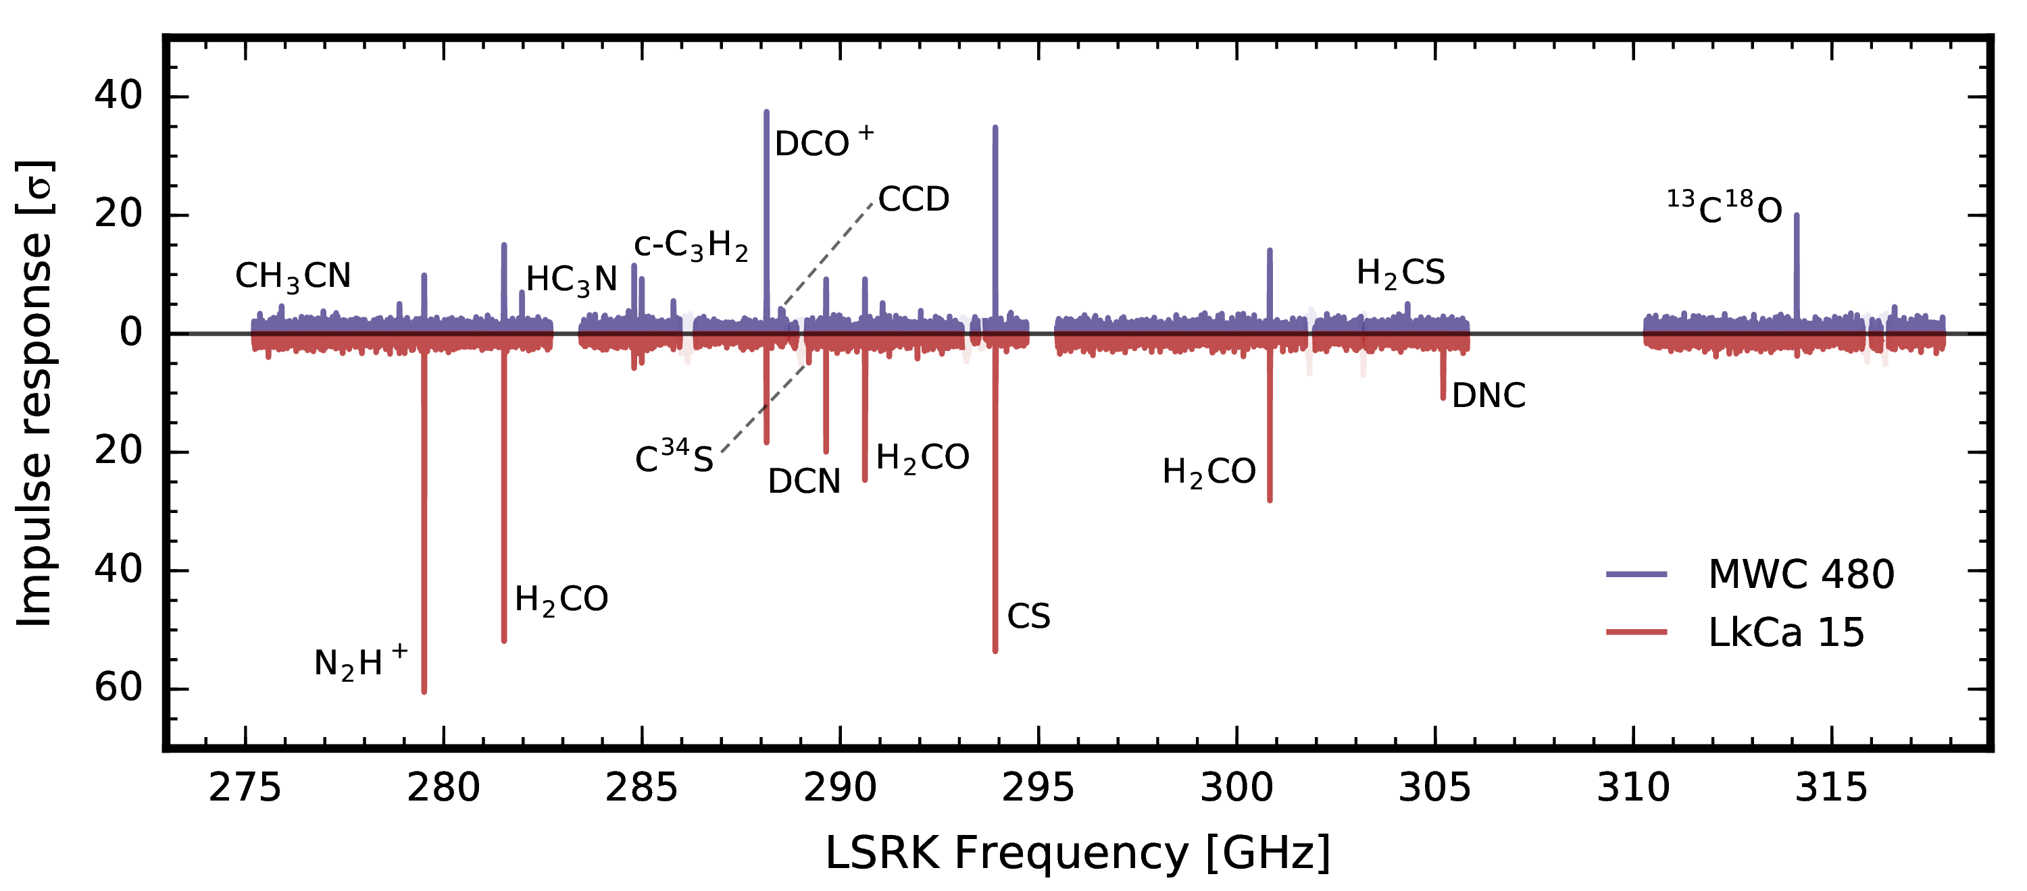
ALMA Band 7 Disk Spectral Survey
Aperture-extraction
~40-50 hrs to image, clean, and extract spectra
10 detected species
Matched filtering
~30 min to filter entire survey
SNR 2-3x higher
16 detected species
5 new disk species: ¹³CS, C³⁴S, DNC, CCD, H₂CS
[Loomis + in prep]

Slide 40
Summary
Matched filtering can boost SNR of weak spectral lines by >500%
Useful for fast uv plane analysis of large bandwidth datasets
  No prior imaging necessary!
Not limited to disks – method is general
  Ideal for resolved sources with PV structure

Slide 41
Outline
  Matched filtering for improved weak spectral line detection
  Generalized Briggs weighting for improved image fidelity

Slide 42
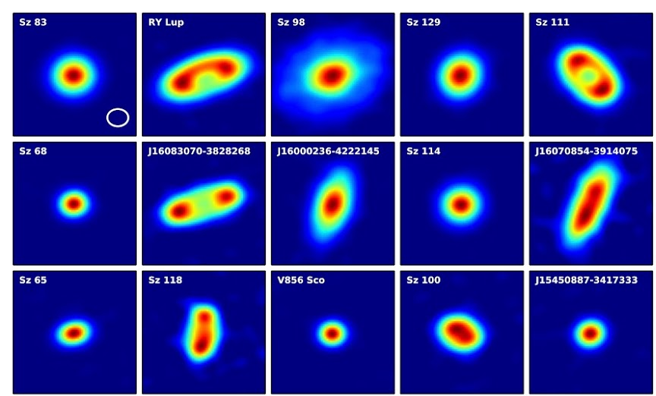
Motivation
Many resolved sources now showing sub-structure
SNR limitations may prevent imaging this sub-structure in weaker sources
Ansdell + 2016
Notes:
----- Meeting Notes (10/6/16 14:59) -----
maybe even explicitly mention brigg's thesis chapter 3.5.2 (e.g.)

Slide 43
Types of weighting
Natural – lowest rms in dirty image
Uniform – lowest sidelobes, higher resolution
Robust – tunable between natural and uniform
  Retains benefits of both
Tapering – generally Gaussian taper
  Sacrifices resolution for increased sensitivity to extended structure

Slide 44
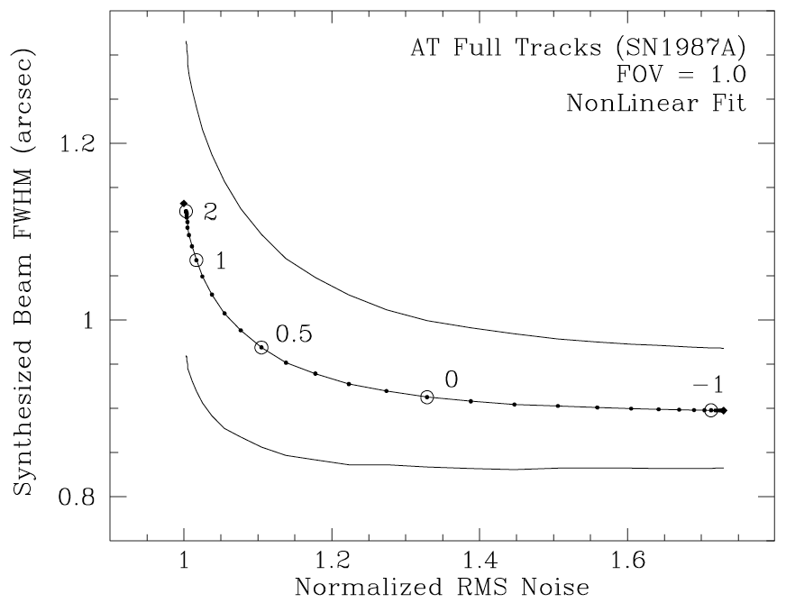
Robust weighting
Briggs 1995

Slide 45
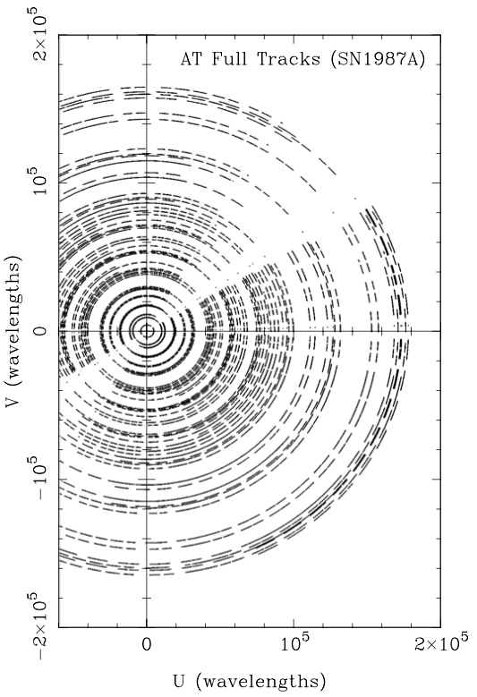
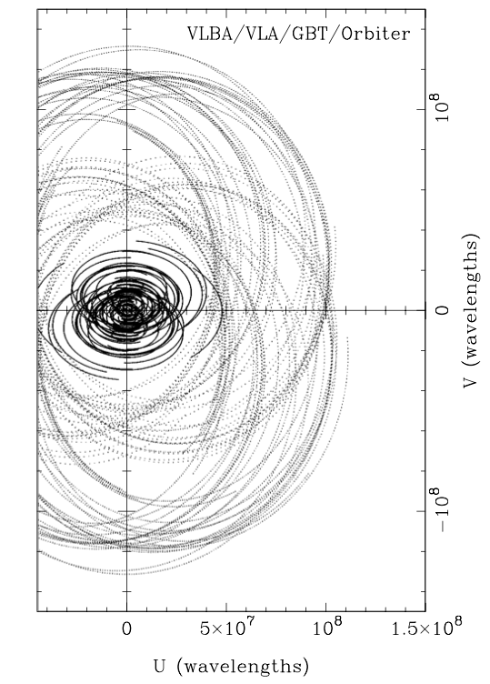
UV coverage and array balance
Briggs 1995

Slide 46
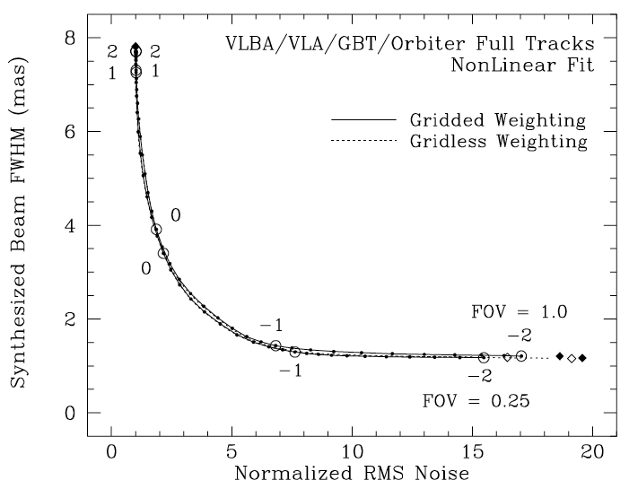
Robust weighting
Briggs 1995

Slide 47
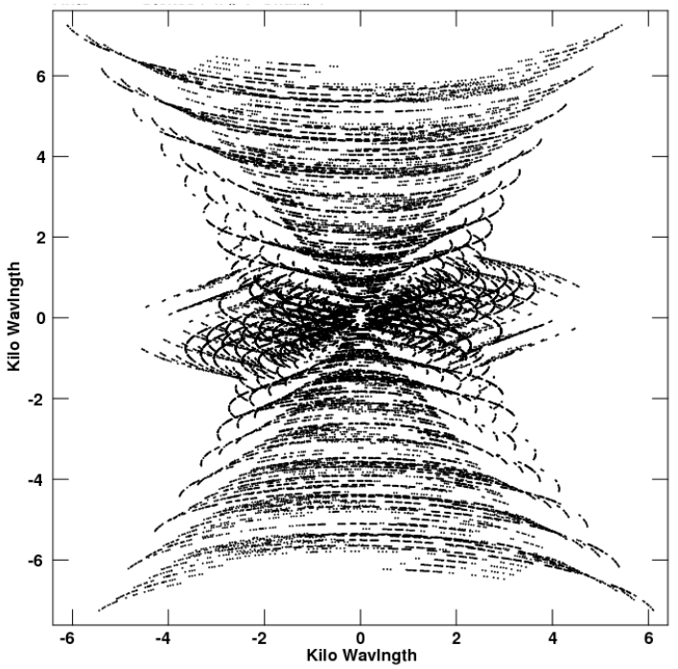
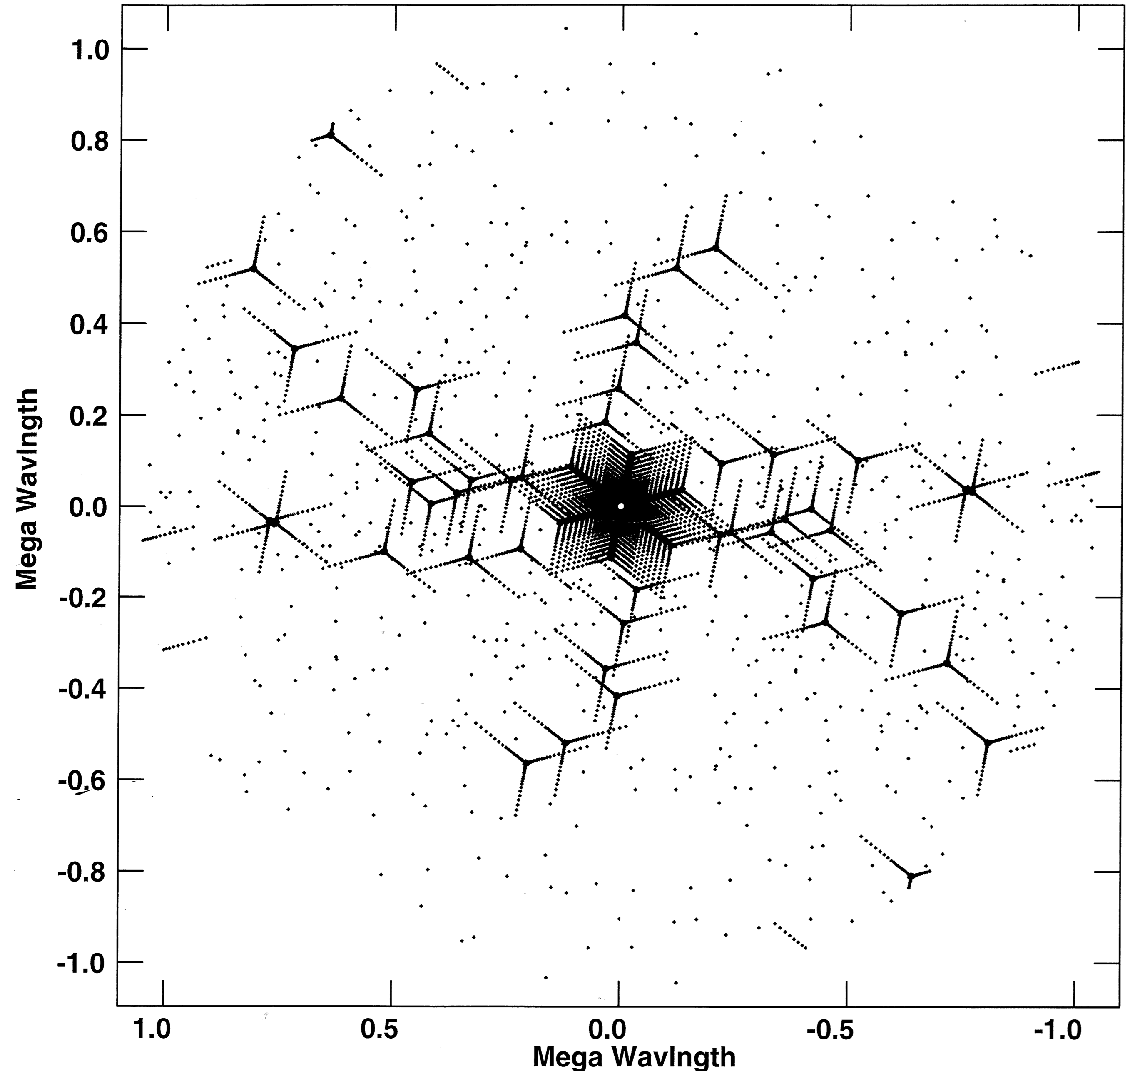
UV coverage and array balance
ALMA
ngVLA
Eric Murphy’s bulletin board

Slide 48
Why does robust weighting work?

Slide 49
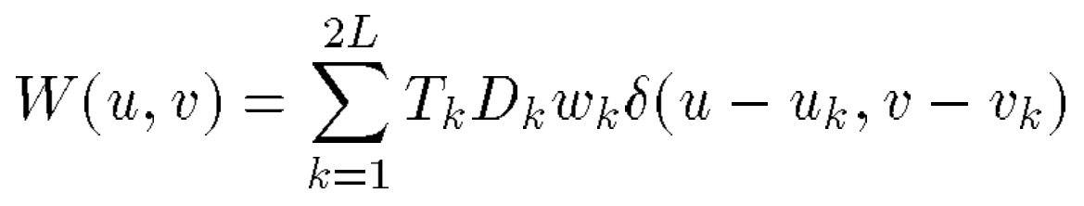
Definitions
Weights:
Briggs 1995

Slide 50
Definitions
Weights:
Taper weights
Briggs 1995

Slide 51
Definitions
Weights:
Taper weights
Density weights
Briggs 1995

Slide 52
Definitions
Weights:
Taper weights
Density weights
SNR weights = 1/σ_{k}²
Briggs 1995

Slide 53
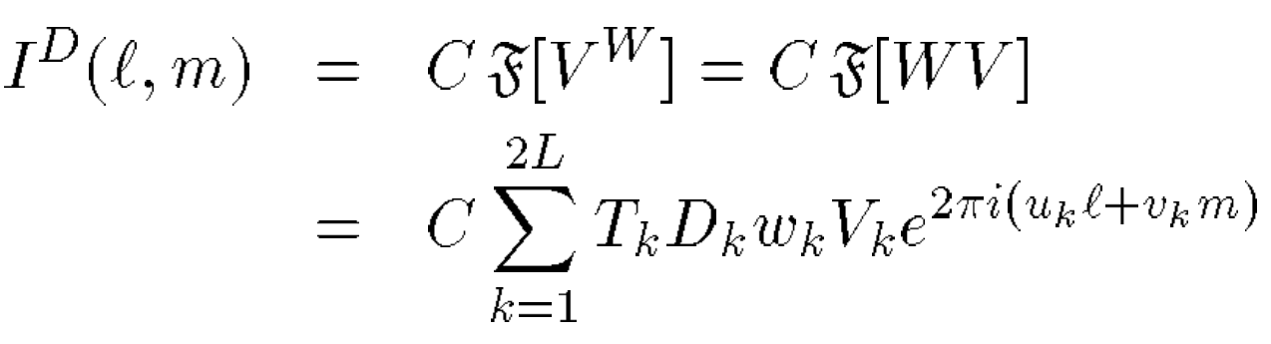
Definitions
Weights:
Taper weights
Density weights
SNR weights = 1/σ_{k}²
Dirty image:
Briggs 1995

Slide 54
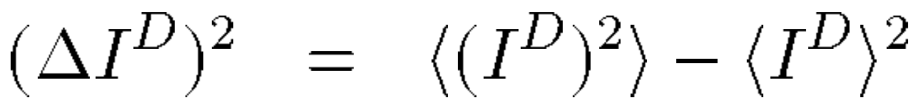
Definitions
Weights:
Taper weights
Density weights
SNR weights = 1/σ_{k}²
Dirty image:
Variance of the dirty image:
Briggs 1995

Slide 55
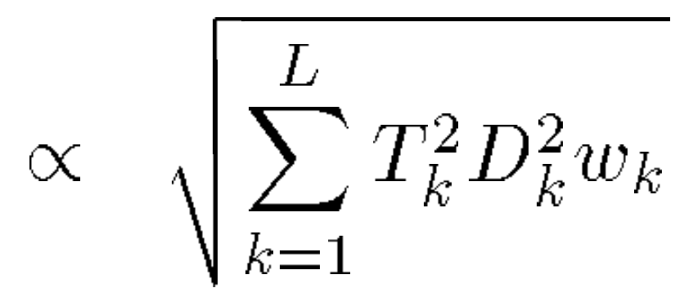
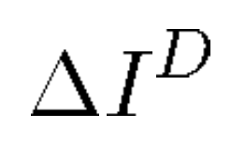
Definitions
Weights:
Taper weights
Density weights
SNR weights = 1/σ_{k}²
Dirty image:
Variance of the dirty image:
RMS thermal noise:
Briggs 1995

Slide 56
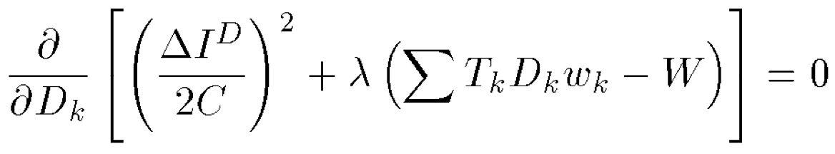
Natural weighting
Minimize (ΔI^{D})² using Lagrangian multiplier:
Briggs 1995

Slide 57
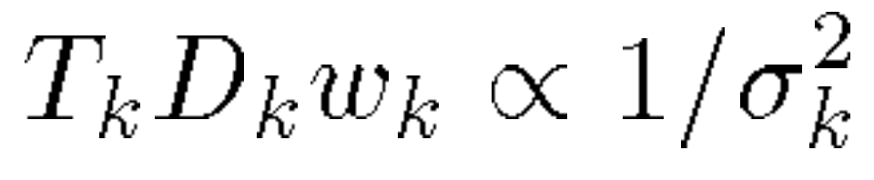
Natural weighting
Minimize (ΔI^{D})² using Lagrangian multiplier:
Thermal noise is lowest if T_{k} and D_{k} = 1, as w_{k} = 1/σ_{k}²
Briggs 1995

Slide 58
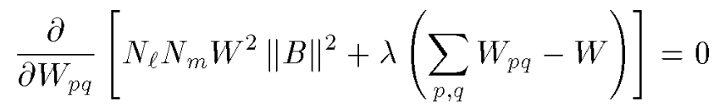
Uniform weighting
Minimize sidelobes by minimizing beam power ||B||²:
Briggs 1995

Slide 59
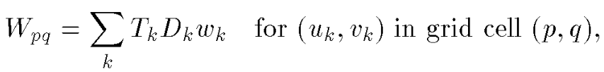
Uniform weighting
Minimize sidelobes by minimizing beam power ||B||²:
Briggs 1995

Slide 60
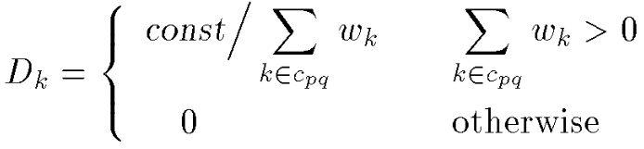
Uniform weighting
Minimize sidelobes by minimizing beam power ||B||²:
Briggs 1995

Slide 61
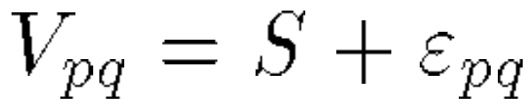
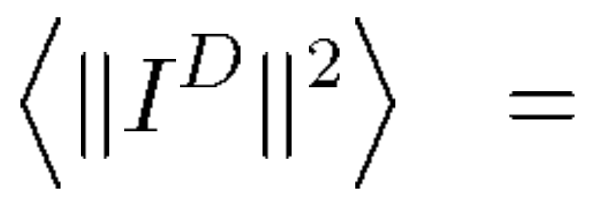
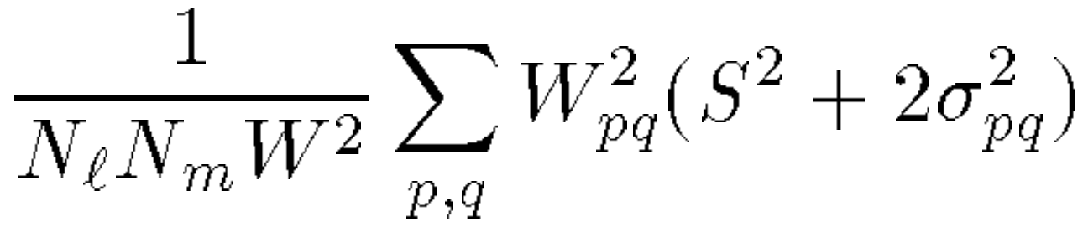
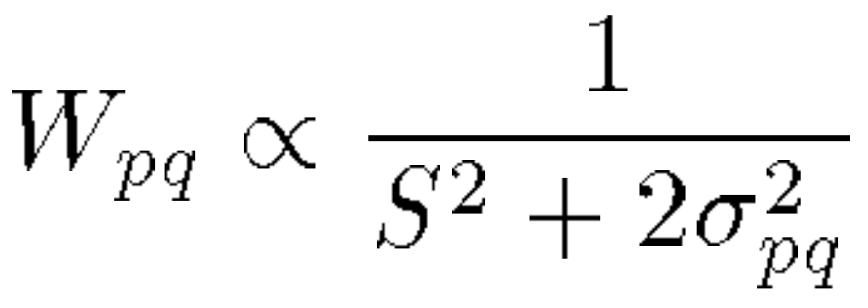
Robust weighting
Find a smooth knob between natural and uniform weighting through minimization
Briggs 1995

Slide 62
‘Natural’ weighting for a resolved source
Natural weighting is only ideal for a point source
Briggs 1995

Slide 63
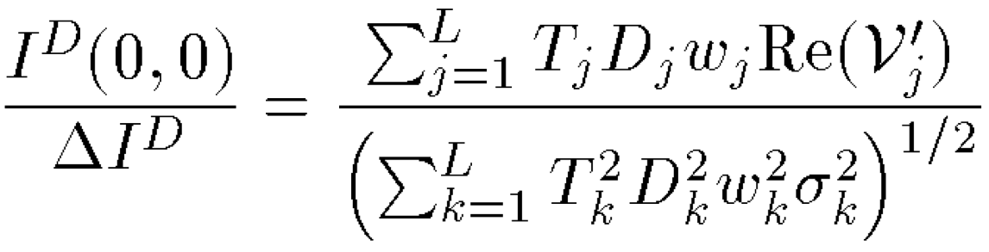
‘Natural’ weighting for a resolved source
Natural weighting is only ideal for a point source
Maximize SNR for an arbitrary source: V
SNR:
Briggs 1995

Slide 64
‘Natural’ weighting for a resolved source
Natural weighting is only ideal for a point source
Maximize SNR for an arbitrary source: V
SNR:
T_{k}D_{k}w_{k} 1/σ_{k}² becomes: T_{k}D_{k}w_{k} Re(V_{k})/σ_{k}²
Briggs 1995

Slide 65
‘Natural’ weighting for a resolved source
Natural weighting is only ideal for a point source
Maximize SNR for an arbitrary source: V
SNR:
T_{k}D_{k}w_{k} 1/σ_{k}² becomes: T_{k}D_{k}w_{k} Re(V_{k})/σ_{k}²
Gaussian tapering increases SNR of resolved sources because the taper approximates a matched filter
T_{k}D_{k}w_{k} |V_{k}|/σ_{k}²
Briggs 1995

Slide 66
Generalized Briggs robust weighting
Can we find a way to connect matched filter weighting with uniform weighting?

Slide 67
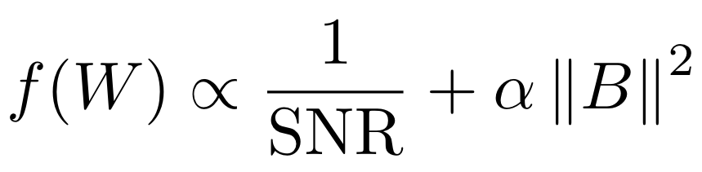
Generalized Briggs robust weighting
Can we find a way to connect matched filter weighting with uniform weighting?
Minimize:

Slide 68
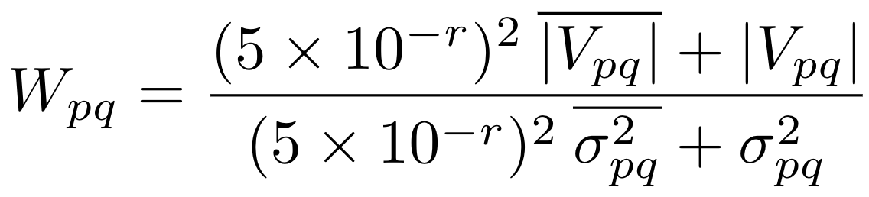
Generalized Briggs robust weighting
Can we find a way to connect matched filter weighting with uniform weighting?
Minimize:
Find that:

Slide 69
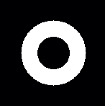
Test case - ring
Robust
Gaussian taper
Generalized robust

Slide 70
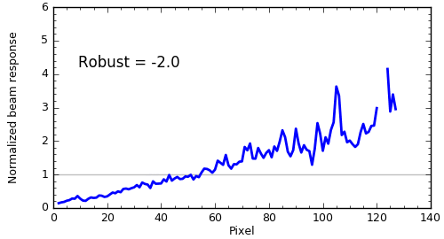
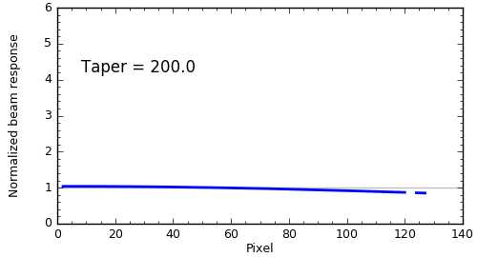

Test case - ring
Robust weighting
Gaussian taper
Generalized robust

Slide 71

Realistic example – AA Tau
Robust
Gaussian taper
Generalized robust

Slide 72


Realistic example – AA Tau
Uniform weighting
Generalized Briggs
SNR = 49
SNR = 87
Loomis + 2017

Slide 73
Summary
Generalized robust weighting outperforms robust weighting for all extended sources, and reduces to robust weighting for point sources
Especially shines in comparison to tapering, good for cases where you need a little extra SNR, but want to preserve resolution
Need knowledge of source structure – CLEAN model is an estimate of this!

Slide 74
Summary
Matched filtering allows priors to be leveraged, increasing spectral SNR and image fidelity
Prior constraints can be derived from the data itself, or from astrophysical/chemical models
VISIBLE tool available for use! Check it out at: github.com/AstroChem/VISIBLE
Generalized robust weighting implemented in CASA, stay tuned for release

Slide 75
SNR boost is proportional to resolution

Slide 76
Kernel generation

Slide 77
vis_sample
Python implementation of uvmodelhttps://github.com/AstroChem/vis_sample
~25% faster than uvmodel
Accepts FITS cubes (i.e. from LIME) and RADMC-3D output files
Interfaces with CASA measurement sets (input and output)

Slide 78
Development for survey implementation
  Kernel interpolation
  Streamlined loading of data
  Automated line identification
  Response normalization
  Response spectra regridding and averaging
  Screening against catalogues

Slide 79
Disk Spectral Survey
  MWC 480 – 12 species (¹³C¹⁸O, N₂H⁺, DCN, DCO⁺, CH₃CN, HC₃N, C₂D, c-C₃H_{2,} H₂CO, H₂CN, H₂CS, CS)
  LkCa 15 – 10 species (¹³C¹⁸O, N₂H⁺, DCN, DCO⁺, DNC, c-C₃H_{2,} H₂CO, H₂CN, CS, C³⁴S)

